Slide 1
CHARLIE AND THE CHOCOLATE FACTORY
PROJECT WITH THE CHAPITRE SECONDARY SCHOOL

Slide 2
scenario
Tim Burton a l'intention de réaliser une nouvelle version de son film : « Charlie et la Chocolaterie ». Il demande aux élèves de votre classe de lui proposer de nouveaux personnages pouvant évoluer autour de Charlie. Fait par les élèves du Chapitre avec Mme Tietgen
Tâche intermédiaire: "après avoir vu ce film, un des personnages vous a vraiment marqué et vous décidez d'appeler un ami pour lui parler de ce personnage" ( je peux m’exprimer sur mon personnage préféré).
_ casting du meilleur candidat pour reprendre la chocolaterie(EOC) (parmi ceux du Chapitre, avant d’éliminer les autres « quel accident dans l’usine de W.Wonka?; quelle pièce ? »)

Slide 3
CHARACTERS’NAMES
Melody Rich( created by Alaeddine+Yannys) ;
Little Shy(created by Amandine+Nessrine);
Bettee Shy and Luna Shy (created by Deniz+Deborah);
Steven Smith(created by Mohamed+Ahmet);
Angelina Lovely(created by Oceane+ Sonia);
Ryan Fashion(created by Theo+Nejma);
Loli Pop(created by Tiguidanke+Lea);
Mike Discreet (created by Tiguidanke+Ismael)

Slide 4
TACHE FINALE
Par groupe de 2, les élèves de plp imaginent une nouvelle sucrerie pour chaque personnage créé par les 3è du Chapitre et ils préparent ensuite un texte publicitaire pour commercialiser leur nouveau produit. Chaque groupe le présente au groupe classe. Il vous faudra ensuite sélectionner le gagnant parmi les nouveaux personnages créés et trouver le moyen d’éliminer les autres en imaginant dans quelle pièce cela va se produire (création d’une maquette et utilisation du logiciel 3D utilisé en construction) et en fonction des caractéristiques données par les élèves du Chapitre. Vous devrez donc envoyer une lettre à W.Wonka pour le persuader de fabriquer la nouvelle sucrerie.

Slide 5
FINAL TASK
"As a group project , they invent an original candy for each character and write an accompanying commercial to advertise their product. They present their invention and commercial to the class. Finally as they have selected one character (from the Chapitre ‘s creations, they write a letter to persuade Mr Wonka to manufacture only one and market it. Join your ad for your new candy. Afterwards they decide to eliminate the others during their visit in the factory (imagine the type of accident they can have, in relation to their characteristics, and the room where it happens”

Slide 6
GROUP SURVEY
As a conclusion 6 pupils have chosen Amandine and Nessrine’s character (“Little Shy”) = they would rather keep Little Shy character than Pop Loli character because she is discreet and Willy Wonka would appreciate her
To conclude the majority of the group prefers the character of Little Shy because she is nice= they like the character of Little Shy better than Tiguidanke and Lea’s character
The name of our favourite character is Little Shy because she is nice=we prefer this character because she is shy and happy-go-lucky
The story of this character could be a happy ending story = we imagine the character could be the winner

Slide 7
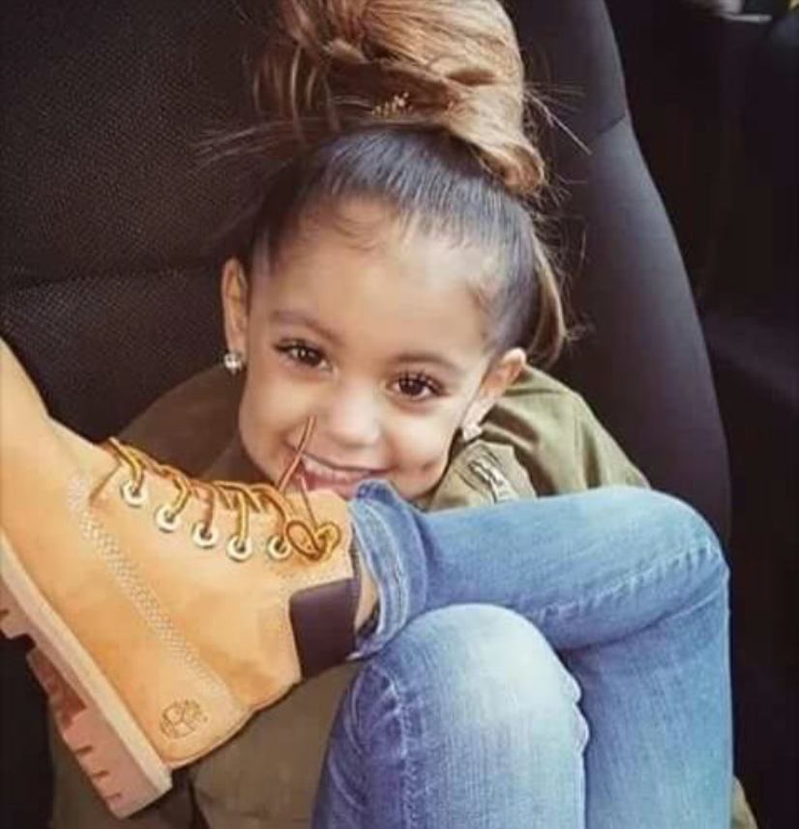
THE GROUP’S CHOICE: little shy

Slide 8
AND THE WINNER IS:

Slide 9
HOW TO MAKE THE OTHER CHARACTERS DISAPPEAR?
HAVE A LOOK!

Slide 10
Melody rich
Melody Rich is clever and friendly but she is stingy.
She tastes chocolates in the tasting room and as she is stingy and selfish, she takes away a tray with bad chocolates; She falls ill= sick and goes to the toilets where she disappears.

Slide 12
Loli pop
Loli Pop is a bad girl, lazy and arrogant.
She doesn’t respect the security distances in the furnace room
So the flames burn her.

Slide 14
Angelina lovely
Angelina Lovely is seductive
Angelina Lovely seduces one Oompa Loompa and dances with him when suddenly another Oompa Loompa pushes inside a dustbin in the invention room.

Slide 16
Luna and betty shy
Luna is stubborn, impatient and protective
Betty is angelic, girly, nice and very curious
Luna and Bettee Shy fight for a chocolate and Luna pushes Bettee in the chocolate crusher but both disappear in the chocolate room

Slide 18
Ryan fashion
Ryan is happy-go-lucky, creative and competitive
Ryan Fashion tested products and there is an explosion in the invention room

Slide 20
Mike discreet
Mike loves butterflies
Mike follows a butterfly that flies over the river; as
Mike follows it, he falls into the river and he gets drowned in the chocolate room near the river

Slide 22
Steven smith
Steven is smart and studious but also pretentious and extremely easily scared
Steven Smith is scared by the noise from the chocolate fall and he has a heart-attack in the chocolate room near the river

Slide 24
THE END!
MADE BY 2PLP FROM ANTOINE VOCATIONAL HIGH SCHOOL WITH THE HELP OF THE 3 FORM FROM LE CHAPITRE SECONDARY SCHOOL

