Slide 1
SUPERHEROES AND ST PATRICK’S DAY
ON MARCH 17TH WAS ST PATRICK’S DAY

Slide 2
FIND A GREEN SUPERHERO

Slide 3
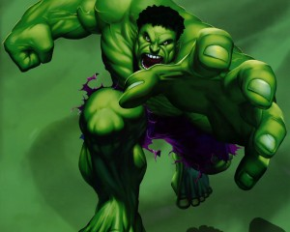
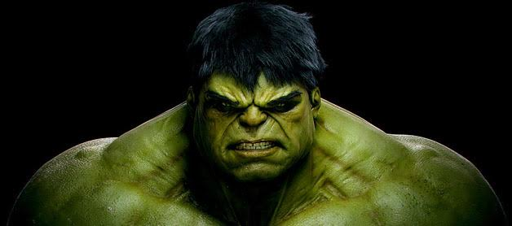

Slide 4
HULK
The Incredible Hulk

Slide 5
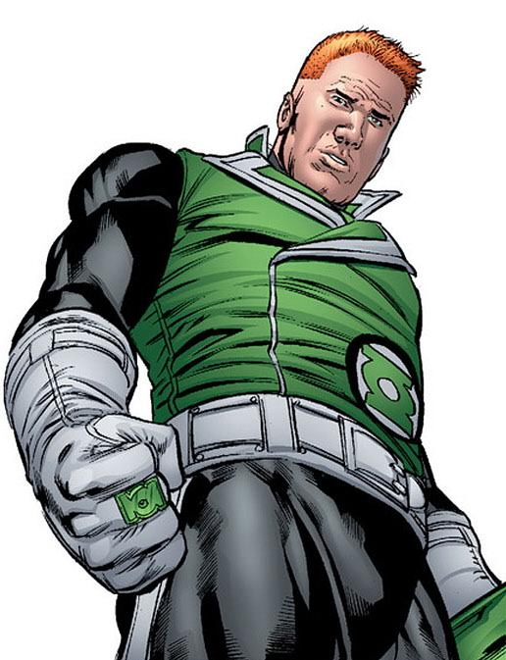
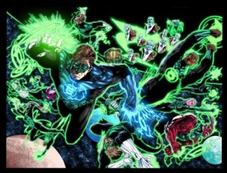

Slide 6
GREEN LANTERN
AND THE GREEN LANTERN CORPS

Slide 7
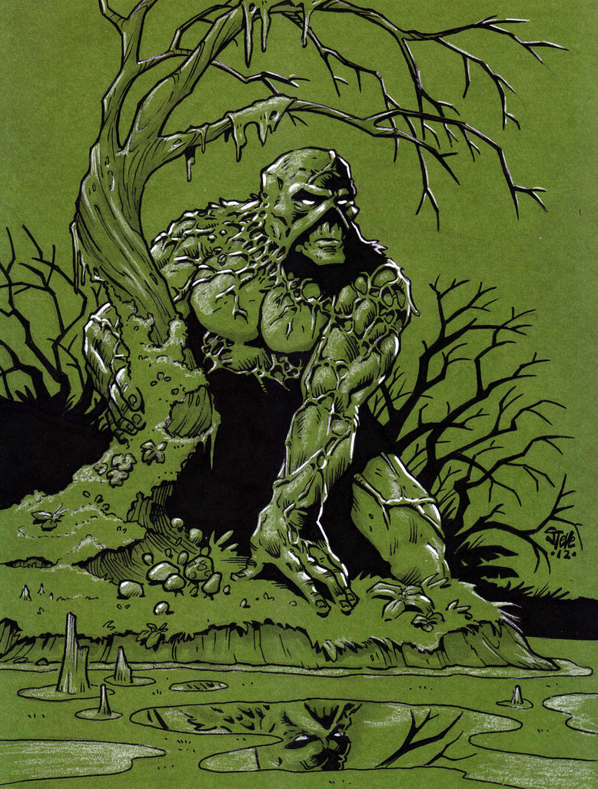
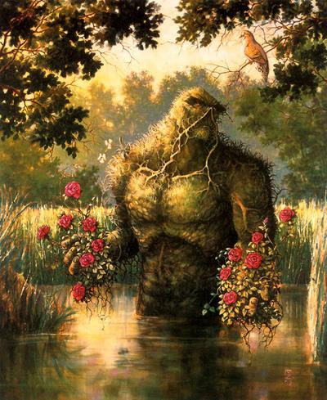

Slide 8
SWAMP THING

Slide 9
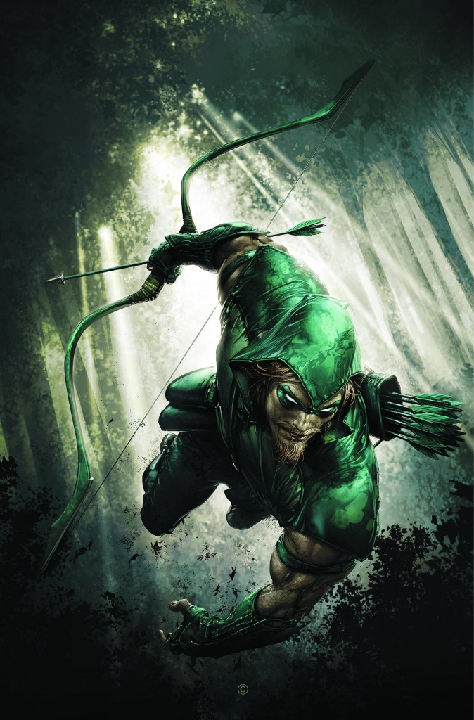

Slide 10
GREEN ARROW
Green Arrow, Oliver Queen, is the DC Universe’s finest archer, a regular human

Slide 11
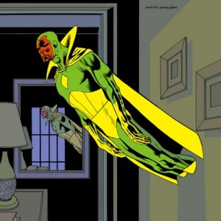

Slide 12
THE VISION
A “synthezoid” created by the villain Ultron, utilizing the remains of the robotic Human Torch and the brainwave patterns of Wonder Man, he was sent to infiltrate and betray The Avengers.

Slide 13
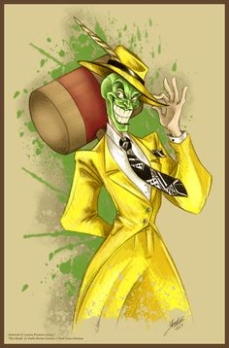

Slide 14
THE MASK
The Mask - Jim Carrey did a good job portraying…

Slide 15
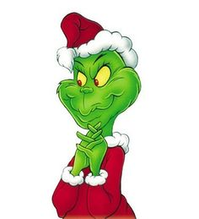

Slide 16
THE GRINCH
The Grinch - thanks, Mahtab Uddin

Slide 17
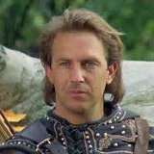
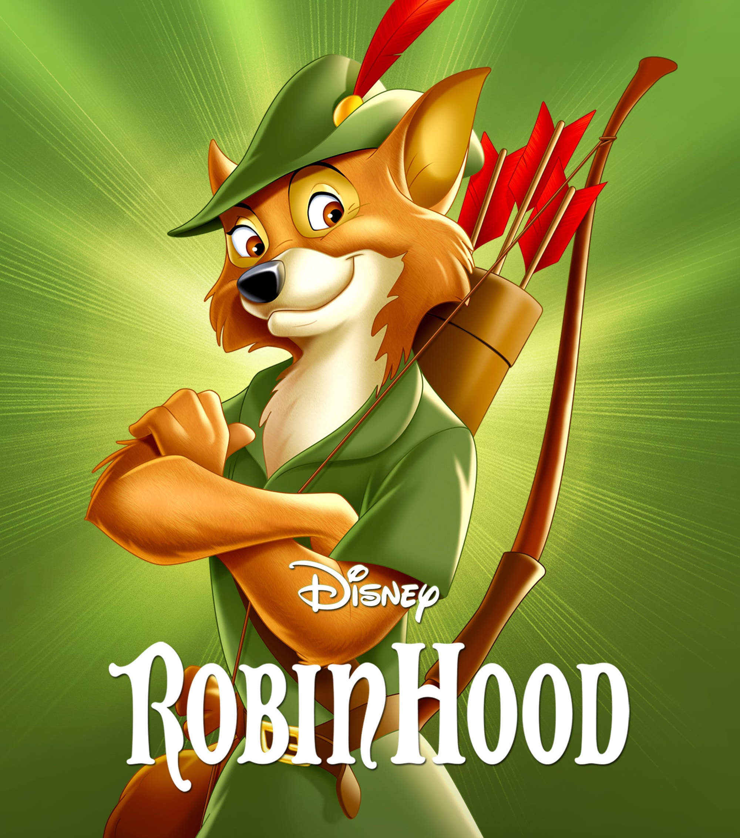
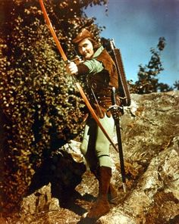

Slide 18
ROBIN HOOD
Robin Hood 1938 - before Kevin Costner, Russell…

Slide 19
VOTE FOR YOUR FAVOURITE GREEN SUPERHERO

Slide 20
HAPPY ST PATRICK’S DAY

Slide 21
ETWINNING EVENT
Let's create a paddlet where we share how we celebrate St. Patrick's Day with our students.
https://padlet.com/isobelita/paddys

