Slide 2
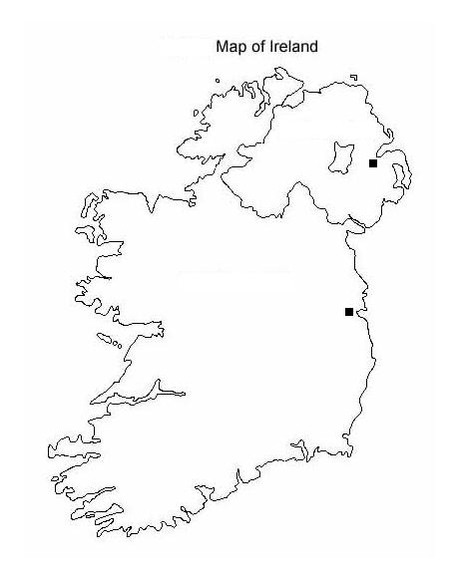

Slide 3
What Irish symbols do you know ?

Slide 4
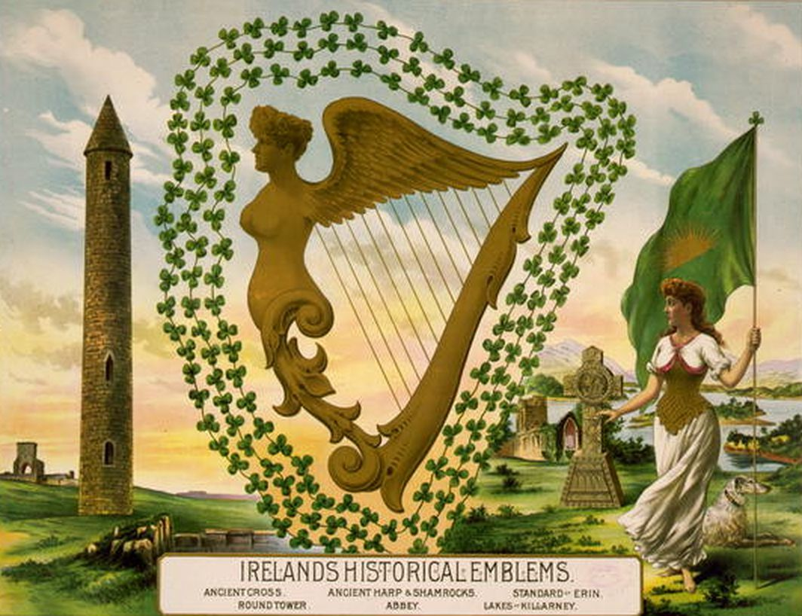

Slide 6
St. Patrick’s Day Symbols
St. Patrick never drove snakes from Ireland; the story is a metaphor for driving paganism from the island.
The traditional meal of Irish bacon and cabbage has been modified in the United States. Irish bacon has been replaced with corned beef for the annual feast.
Music has always been an important part of Irish life. Irish music is produced with instruments like the fiddle, the uilleann pipes, the tin whistle, and the bodhran.

Slide 7
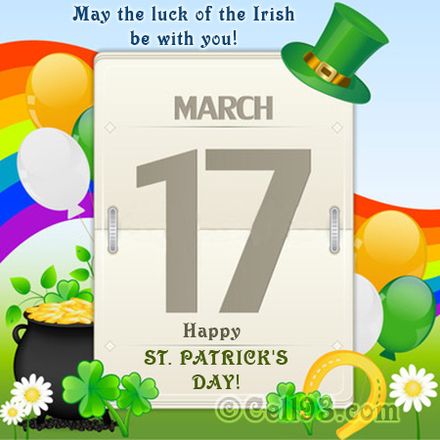

Slide 9
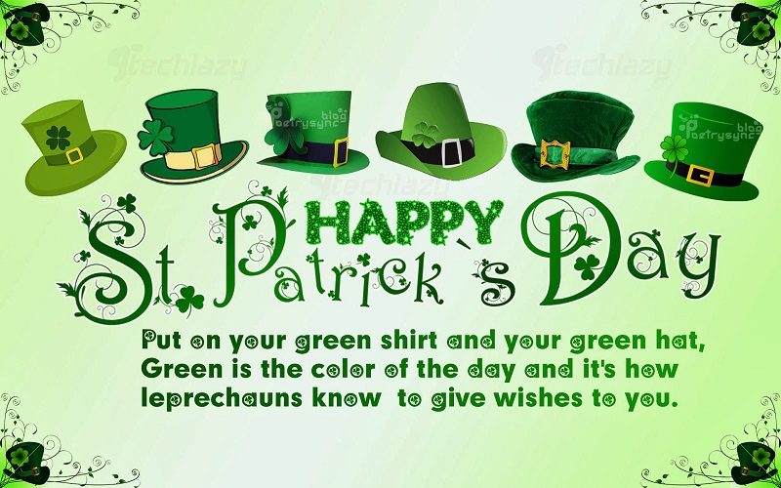

Slide 10
